Slide 1
T. Asfour and R. Dillmann

Slide 2
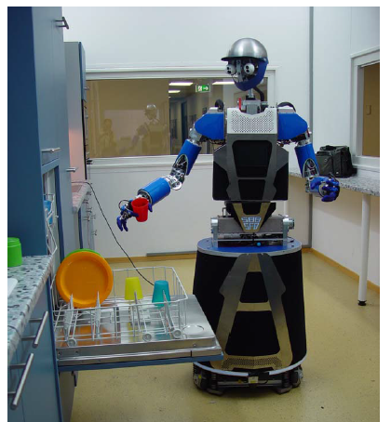

Slide 3
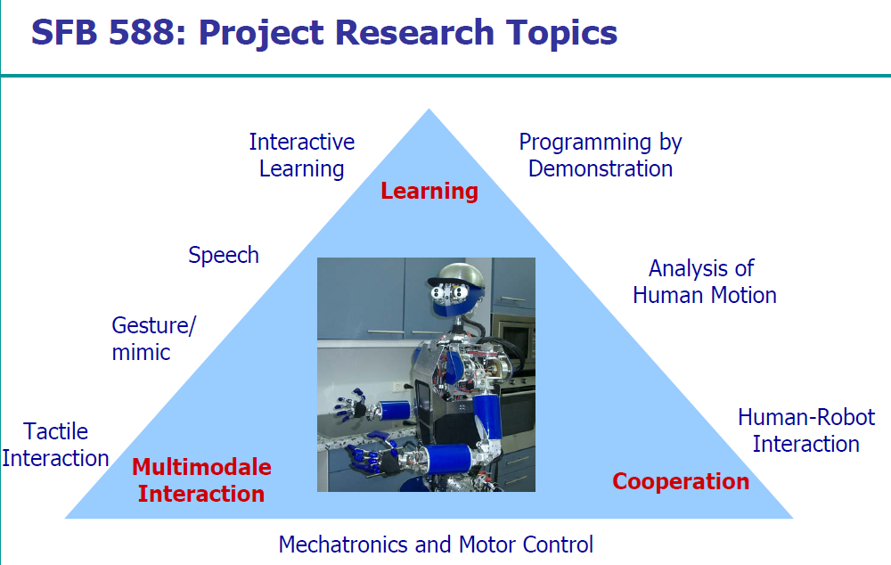

Slide 4
Outline of the talk
The humanoid robot ARMAR-III
  Mechatronics
  Hardware architecture
  Software framework
Implemented Skills
  • Object recognition and localization
  • Inverse Kinematics
  • Path Planning/Collision detection

Slide 5
Homework:
Kinematic Model of the robot

Slide 6
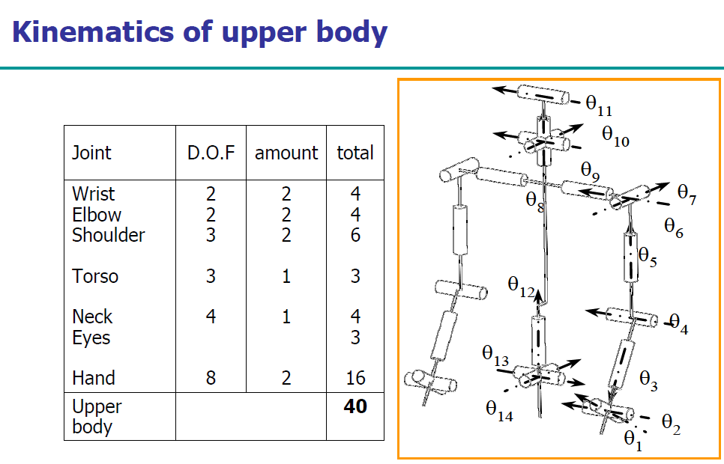

Slide 7
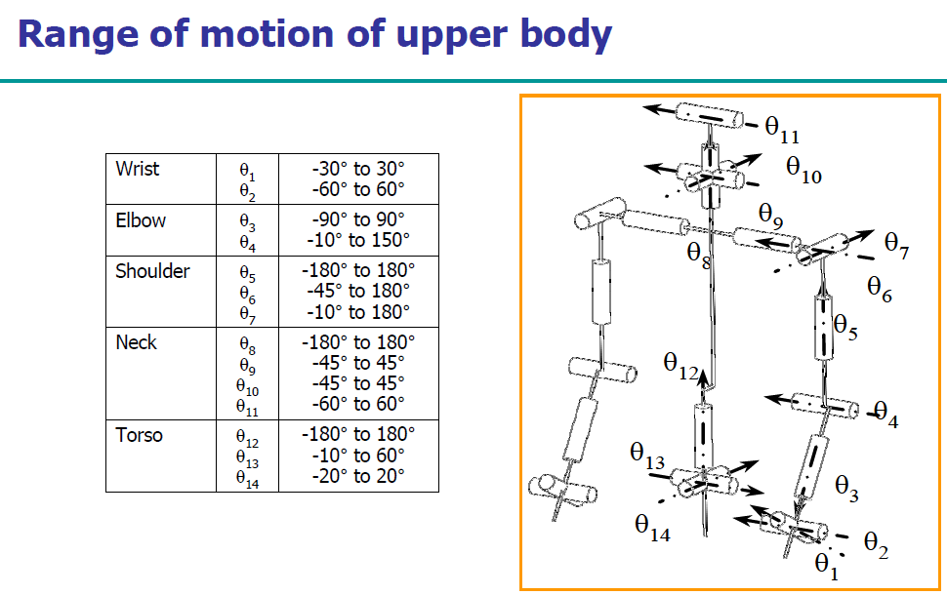

Slide 8
Homework to be returned on Thursday
Create a model as in the previous two slides for your robot

Slide 9
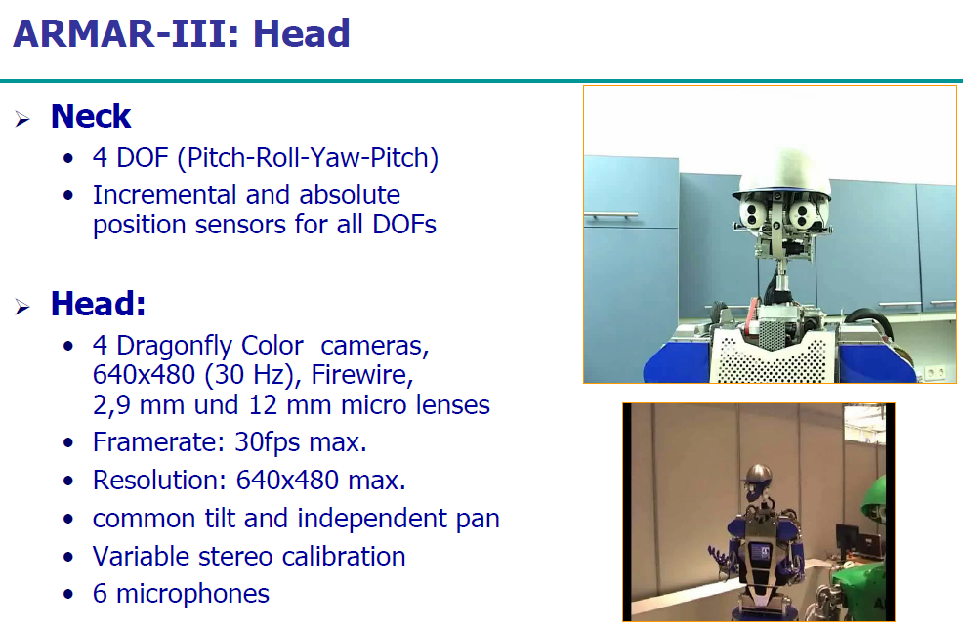

Slide 10
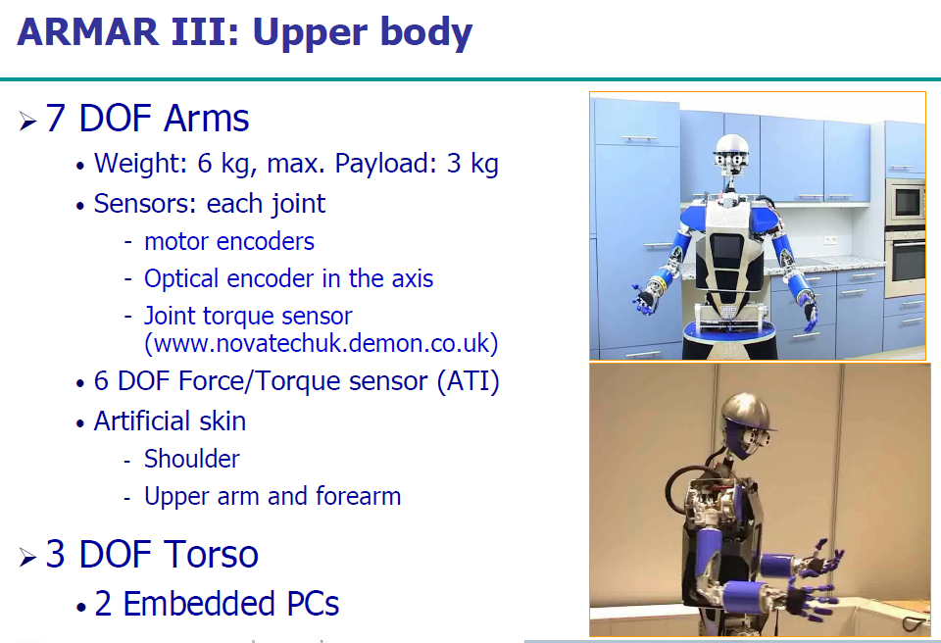

Slide 11
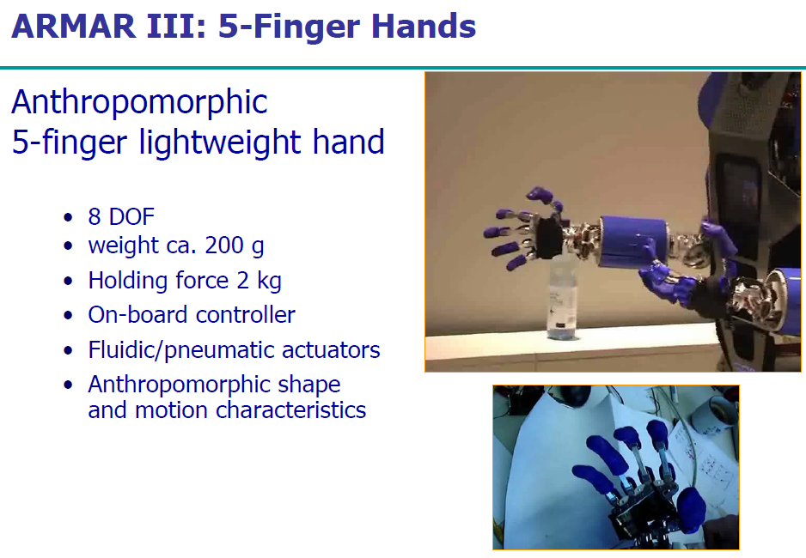

Slide 12
Platform or Base

Slide 13
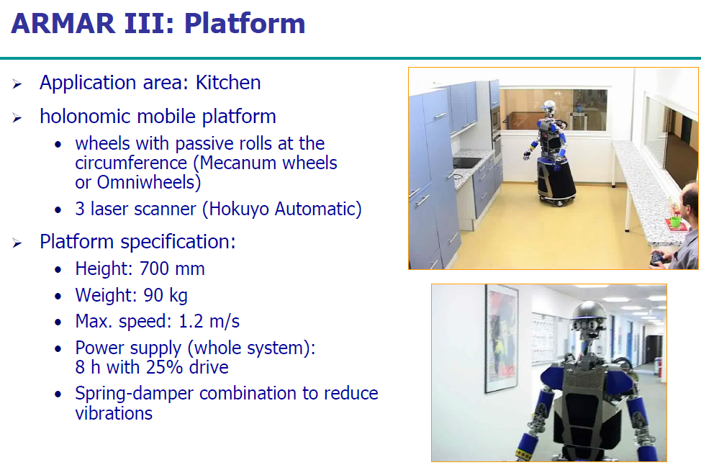

Slide 14
Kinematics

Slide 15
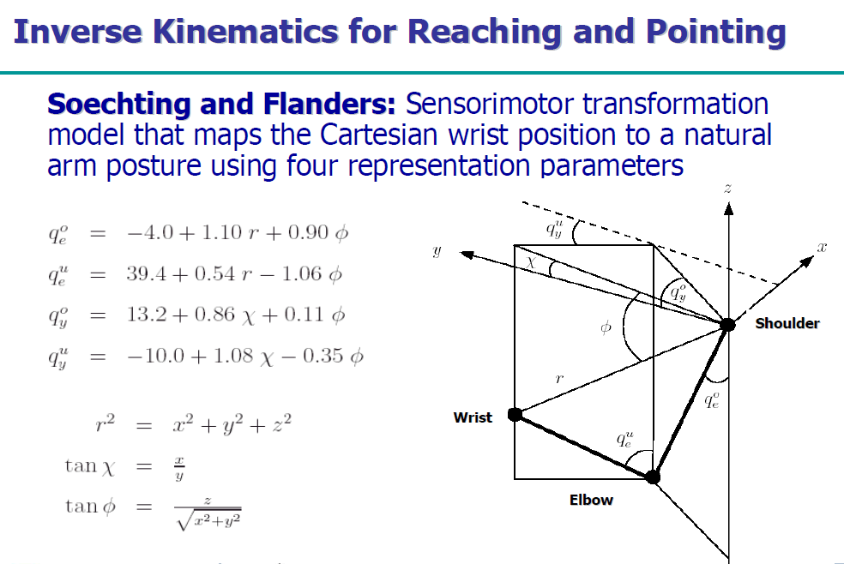

Slide 16
